Slide 1

ASTRO CATS
Project Update 2/5/16
Notes:
Aaron

Slide 2
Team Roster
Nick Fagan Aaron Deutsch Kevin Eliason Gabriel Puente-Lay Brandon Horne Cameron Crippa Caleb Wasmund Andrew Auffenberg Justin Mulloney Jacob Chesley

Slide 3
Progress
Completed subscale rocket test
Collected accelerometer data
Completed radio test
1+ mile range
Ordered all final components
Rocket, motors, parachutes

Slide 4
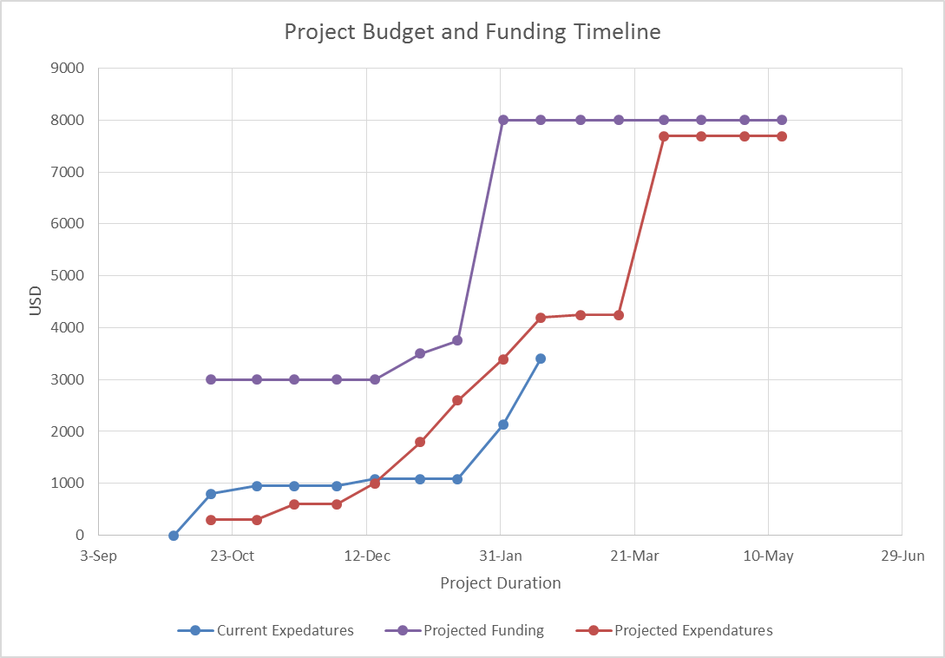

Slide 5
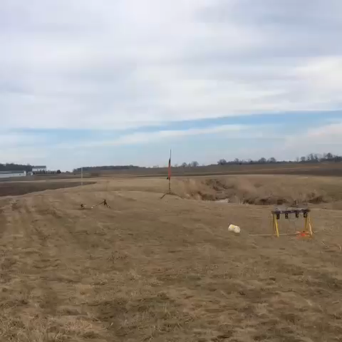
Subscale Launch
A subscale launch was completed on January 30th
The launch provided us with acceleration data as well as a chance for us to test our communications

Slide 6
Accelerometer Data

Slide 7
Drag/Cd Data
Based on accelerometer data we were able to get an estimated coefficient of drag
Coefficient of Drag came out to be roughly .58, and we are still working on analyzing that number

Slide 8
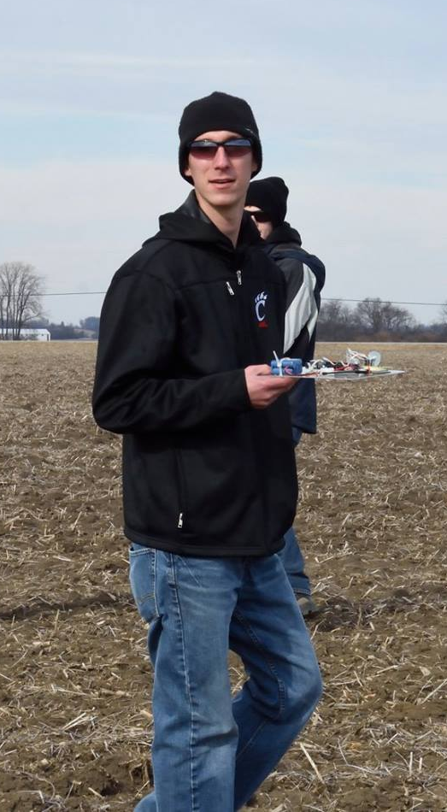
Radio Distance Test
Set up the ground station.
Walked 1 mile away from ground station.
Used cell phones to find GPS coordinates
Radio can receive data with sensitivity down to -100 dBm.
1.04 miles away on ground, -90 dBm. Within range.

Slide 9
Plans for next Radio Test
Add GPS to traveling radio module.
This will allow the module to calculate distance between starting point (ground station) and current position, and report distance back to us.
Plot Distance vs Radio Strength
The radio module will be able to communicate back it’s distance to the ground station, and ground station will report back signal strength. We can plot distance vs signal strength to find maximum allowed distance on ground.

Slide 10
Ground Control Software Demo

